Slide 1
LECTURE 3
Briquetting (form pieces of regular shapes)
EXTRACTIVE METALLURGY- FIRST CLASS
FERROUS EXTRACTIVE METALLURGY
Briquetting consists of heating and
compressing the fine particles of iron ores into pieces of regular shape using rolls, punches and extruders without
the need for binders. This process is generally more expensive than other agglomerating processes due to wear (friction/abrasion) of the briquetting

Slide 2
surfaces and the energy required to
EXTRACTIVE METALLURGY- FIRST CLASS
FERROUS EXTRACTIVE METALLURGY
compress the pieces.
Pelletizing
Pellets are made by combining moist
(wet) ore with a binder and rolling it into balls using either a pelletizing
disc or a pelletizing drum. The pellets are then dried, preheated, and finally heated to approximately 1300 ⁰C ,

Slide 3
which is lower than the melting point
EXTRACTIVE METALLURGY- FIRST CLASS
FERROUS EXTRACTIVE METALLURGY
of iron oxides to harden them.
Sufficient moisture is needed to
make the ore sticky enough to pelletize but not so much moisture
that the ore becomes ‘‘muddy.’’
A binder is necessary to hold the particle grains together after the
So, pelletizing requirements:
has the following

Slide 4
pellets dried and before it is finally
EXTRACTIVE METALLURGY- FIRST CLASS
FERROUS EXTRACTIVE METALLURGY
hardened.
The pelletization process is very widely used, particularly when the ore
must be shipped great distances between the mine and the blast furnace, because the fired pellets are durable and easy to handle. The pellets also perform very well in the blast furnace, with good bed

Slide 5
permeability and reducibility
EXTRACTIVE METALLURGY- FIRST CLASS
FERROUS EXTRACTIVE METALLURGY
(extraction). The selection of a proper
binder type and amount is of critical importance in producing good quality
pellets at a reasonable price.
Extraction of Iron
Three raw materials required for the
process of iron extraction, which are:
1. Iron Ores: High-grade ores contain 60-70% Fe, medium-grade

Slide 6
40-60% Fe, and low-grade < 40%
EXTRACTIVE METALLURGY- FIRST CLASS
FERROUS EXTRACTIVE METALLURGY
Fe. The world's main supply of iron
is obtained from ores containing Hematite; those containing
magnetite supply only about 5% of the world's iron. The formula of Hematite is Fe2O3. A typical analysis of an iron ore is shown in Table 1.

Slide 7

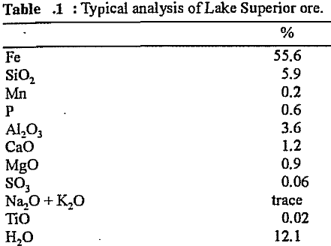
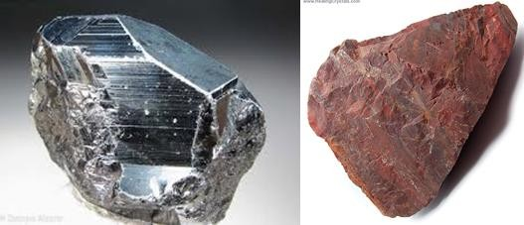
EXTRACTIVE METALLURGY- FIRST CLASS
FERROUS EXTRACTIVE METALLURGY
Figure 1: Iron Ore

Slide 8
2. Coke: Cock or Coal is another
EXTRACTIVE METALLURGY- FIRST CLASS
FERROUS EXTRACTIVE METALLURGY
significant requirement for iron
extraction. It has three functions, as:
A fuel producing the heat required for reduction and melting the iron.
To supply the reducing agent (mainly CO).

Slide 9

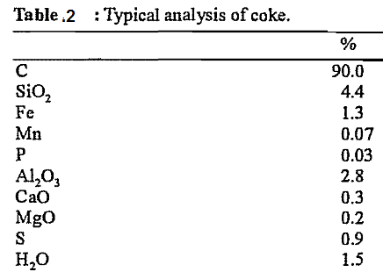
EXTRACTIVE METALLURGY- FIRST CLASS
FERROUS EXTRACTIVE METALLURGY
A small amount of carbon (coal)
dissolves in the hot metal, thus
lowering its melting point.
The typical analysis of presented in table 2.
coal is

Slide 10
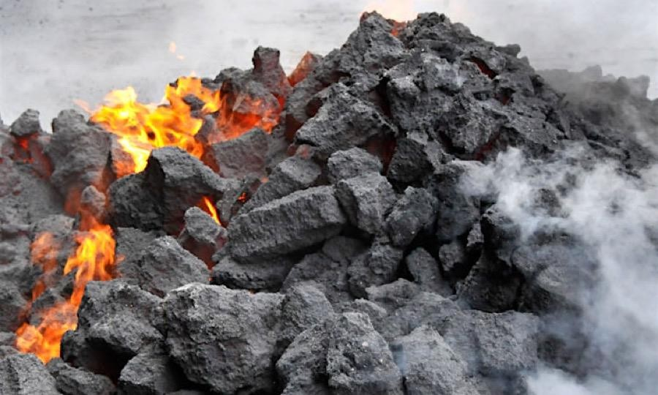
EXTRACTIVE METALLURGY- FIRST CLASS
FERROUS EXTRACTIVE METALLURGY
Figure 2 : Coke (Coal)
3. Limestone: The function of limestone is to reduce the gangue in the ore and the slag of the coke, mainly SiO2 and Al2O3 which have

Slide 11

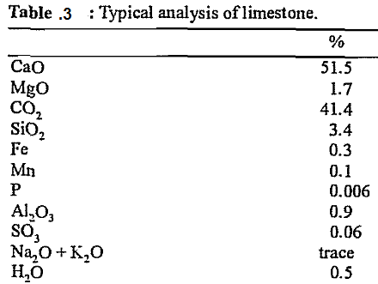
EXTRACTIVE METALLURGY- FIRST CLASS
FERROUS EXTRACTIVE METALLURGY
high melting points. the typical
analysis of limestone is as follows:

Slide 12
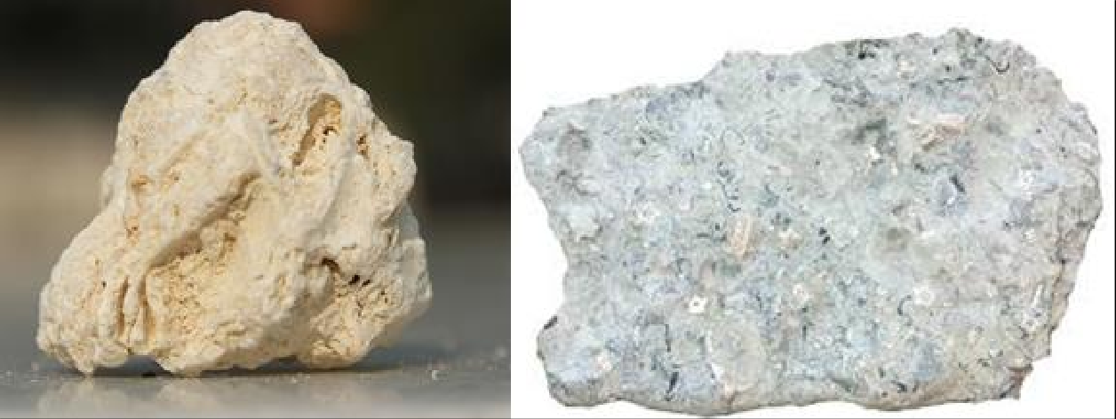
Figure 3: Limestone
EXTRACTIVE METALLURGY- FIRST CLASS
FERROUS EXTRACTIVE METALLURGY

